Slide 1
Northern 3 VCT PLC
Annual General Meeting
9 August 2022
venture
private equity
debt
proprietary capital

Slide 2
Agenda
1.
2.
3.
Overview of the year
Peter Dines
Questions
Peter Dines
Chris Fleetwood
Formal AGM business
Chris Fleetwood

Slide 3
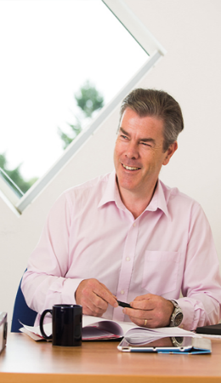
A track record of value creation
Peter Dines
Mercia assets under management
31 March 2022
Northern VCTs
£322million
Other Mercia venture funds
c.£519million*
Other Mercia debt funds
c.£118million
* incl. direct balance sheet portfolio

Slide 4
Dividends and total return

Slide 5
Net asset value

Slide 6
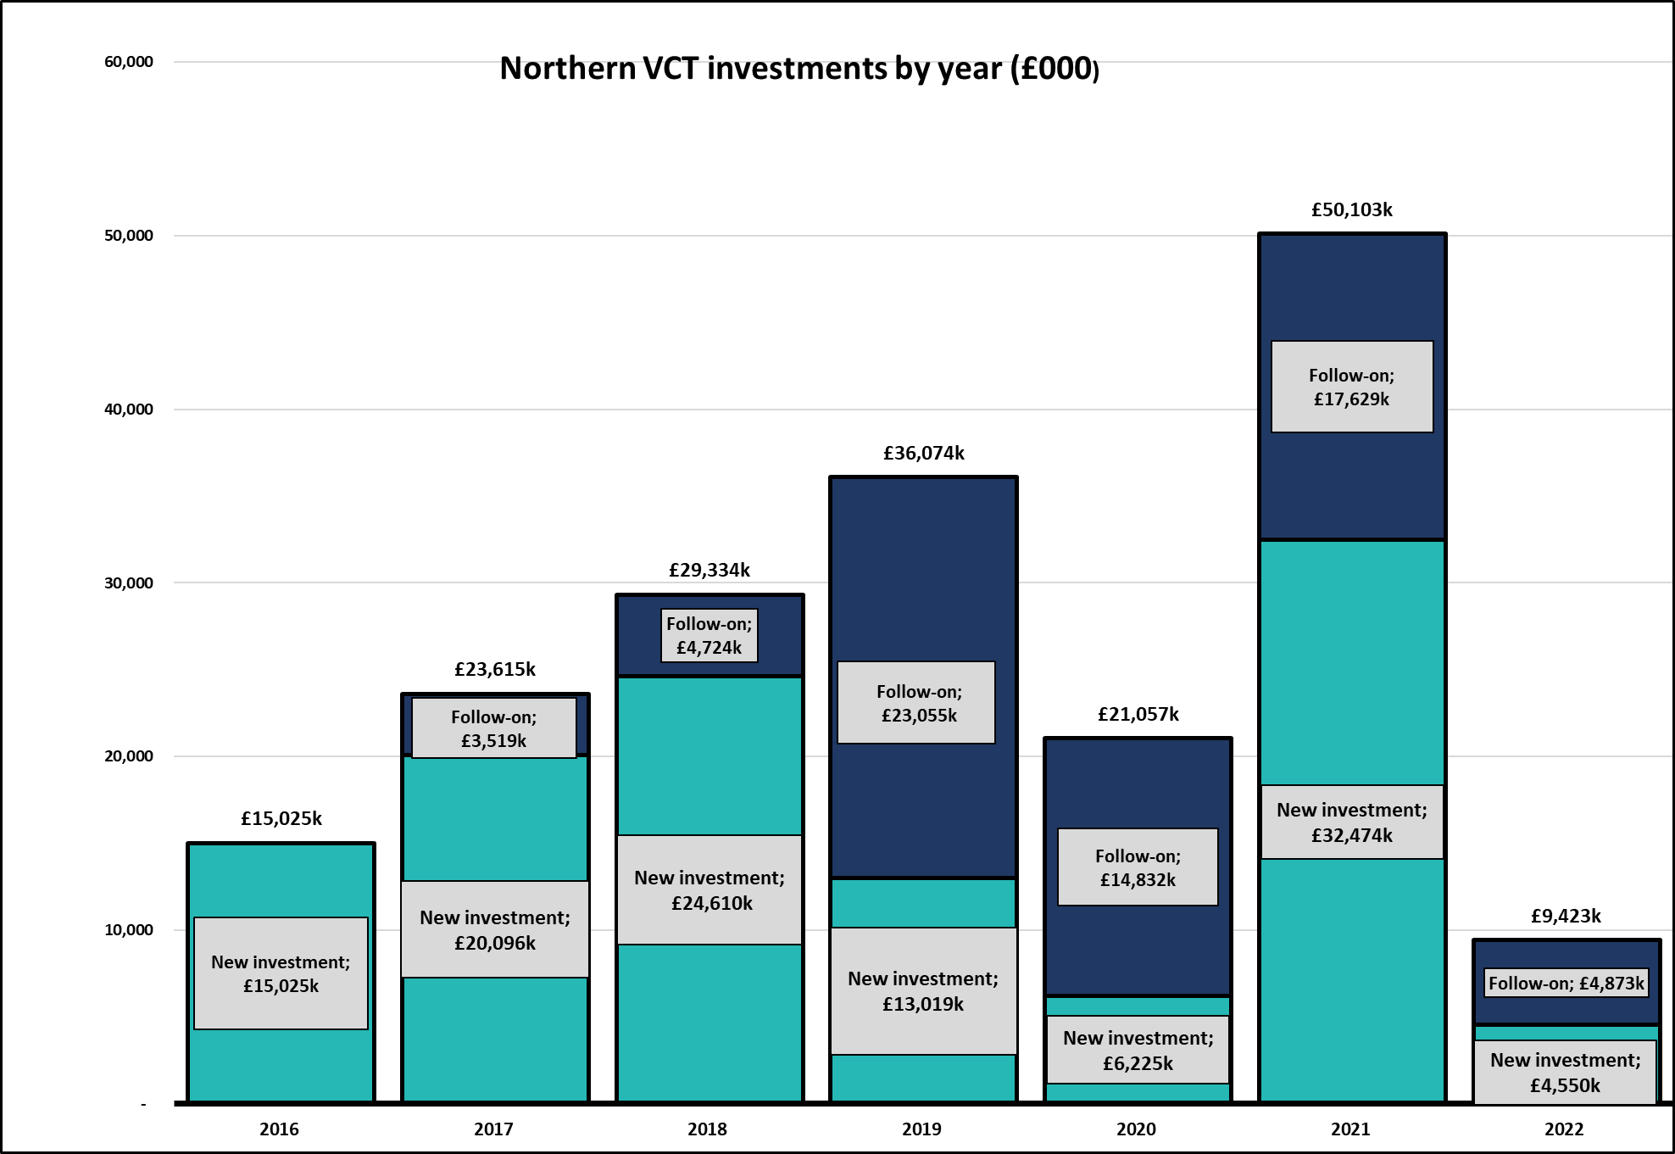
Building a portfolio

Slide 7
New investments
 | N3VCT investment £000
Intechnica Technology consultancy, cyber security and website management | 1,665
Project Glow Topco T/A Currentbody.com Online retailer for home-use beauty devices | 1,519
Broker Insights Platform connecting insurers and brokers | 1,366
Adludio Marketing services provider helping brands run online campaigns | 1,300
Pimberly Product information management software | 935
Forensic Analytics Call data communications analytics software for police forces | 894
Locate Bio Orthobiologics company delivering solutions for surgeons | 813
Naitive Technologies Platform to detect undiagnosed chronic disease with image machine learning | 721
Synthesized Data product enterprise software | 500
TOTAL | 9,713

Slide 8
Northern 3 Venture Trust portfolio as at 31 March 2022

Slide 9
Top 10 investments as at 31 March 2022
 | Cost £000 | Valuation £000 | % of net assets by value
Lineup Systems | 974 | 7,218 | 6.8
Evotix (formerly SHE Software Group) | 2,487 | 5,328 | 5.0
Volumatic Holdings | 216 | 3,338 | 3.1
Grip-UK (T/A The Climbing Hangar) | 3,174 | 3,174 | 3.0
Oddbox | 350 | 3,052 | 2.9
Knowledgemotion | 1,740 | 2,975 | 2.8
Idox (quoted on AIM) | 530 | 2,763 | 2.6
Buoyant Upholstery | 907 | 2,313 | 2.2
Ideagen (quoted on AIM) | 352 | 2,079 | 1.9
Newcells Biotech | 1,592 | 1,904 | 1.8
TOTAL | 12,322 | 34,144 | 32.1

Slide 10
Exits FY22
Current body
Intelling
Online marketplace for
home-use beauty devices
Date of original investment:
March 2018
Amount invested by N3VCT
£1.8m
Receipts over the life of the investment
£5.2m
Return of 2.9x
Customer handling and
support specialist
Date of original investment:
March 2017
Amount invested by N3VCT
£1.1m
Receipts over the life of the investment
£4.1m
Return of 3.6x

Slide 11
Exits FY22 continued
Hello Soda
Mojo mortgages
Data analytics services provider
Date of original investment:
October 2017
Amount invested by N3VCT
£1.5m
Receipts over the life of the investment
£2.4m
Return of 1.6x
Online mortgage broker
Date of original investment:
February 2019
Amount invested by N3VCT
£1.4m
Receipts over the life of the investment
£2.2m
Return of 1.6x

Slide 12
FY22 Partial exits
musicmagpie
Oddbox
Re-Commerce website for pre-owned entertainment media and electronic items
Date of original investment:
September 2015
Amount invested by N3VCT
£1.2m
Proceeds and retained value at IPO
£15.5m
Return of 11.6x at flotation
(Lifetime return currently 7.2x)
Supply and delivery of fruit and vegetable boxes
Date of original investment:
March 2020
Relevant partial amount invested by N3VCT
£0.3m
Receipts over the life of the
investment to date
£3.1m
Return of 10.9x

Slide 13
Exits post year end
Knowledgemotion
Online educational content platform
Date of original investment:
July 2017
Amount invested by N3VCT
£1.7m
Receipts over the life of the investment
£3.0m
Return of 1.7x

Slide 14
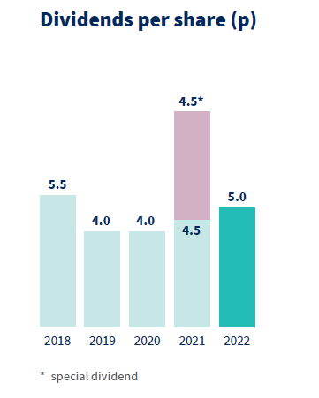
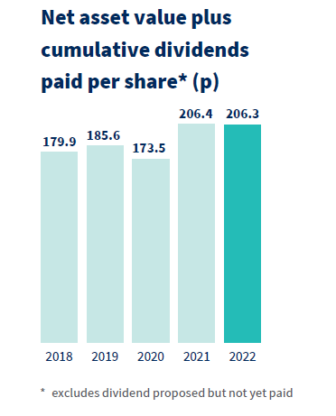
Dividends

Slide 15
Questions
Peter Dines
Chris Fleetwood

Slide 16
Formal AGM business
Chris Fleetwood

Slide 17
Resolution 1:
To receive and approve the financial statements for the year ended 31 March 2022
For: | 5,942,790
Chairman’s Discretion: | 354,527
Against: | 5,408
Vote withheld: | 17,286
Total | 6,320,011

Slide 18
Resolution 2:
To approve and declare a final dividend of 3.0p per share in respect of the year ended 31 March 2022
For: | 5,990,846
Chairman’s Discretion: | 327,322
Against: | -
Vote withheld: | 1,843
Total | 6,320,011

Slide 19
Resolution 3:
To approve the Directors’ remuneration report for the year ended 31 March 2022 other than the part of such report containing the Directors’ remuneration policy
For: | 5,467,469
Chairman’s Discretion: | 379,182
Against: | 263,545
Vote withheld: | 209,815
Total | 6,320,011

Slide 20
Resolution 4:
To re-elect Mr J G D Ferguson as a director
For: | 5,681,983
Chairman’s Discretion: | 365,451
Against: | 181,766
Vote withheld: | 90,811
Total | 6,320,011

Slide 21
Resolution 5:
To re-elect Mr C J Fleetwood as a director
For: | 5,660,500
Chairman’s Discretion: | 365,451
Against: | 203,249
Vote withheld: | 90,811
Total | 6,320,011

Slide 22
Resolution 6:
To re-elect Mr T R Levett as a director
For: | 5,734,930
Chairman’s Discretion: | 365,451
Against: | 128,819
Vote withheld: | 90,811
Total | 6,320,011

Slide 23
Resolution 7:
To re-elect Mr J M O Waddell as a director
For: | 5,586,667
Chairman’s Discretion: | 365,451
Against: | 192,528
Vote withheld: | 175,365
Total | 6,320,011

Slide 24
Resolution 8:
To re-elect Mrs A B Brown as a director
For: | 5,740,485
Chairman’s Discretion: | 354,527
Against: | 56,977
Vote withheld: | 168,022
Total | 6,320,011

Slide 25
Resolution 9:
To re-appoint Mazars LLP as independent auditor of the Company
For: | 5,544,375
Chairman’s Discretion: | 365,451
Against: | 324,425
Vote withheld: | 85,760
Total | 6,320,011

Slide 26
Resolution 10:
To authorise the audit committee to fix the independent auditor’s remuneration
For: | 5,854,452
Chairman’s Discretion: | 354,527
Against: | 44,007
Vote withheld: | 67,025
Total | 6,320,011

Slide 27
Resolution 11:
To authorise the directors to allot shares pursuant to Section 551 of the Companies Act 2006
For: | 5,840,866
Chairman’s Discretion: | 365,527
Against: | 76,791
Vote withheld: | 36,827
Total | 6,320,011

Slide 28
Resolution 12:
To disapply Section 561 of the Companies Act 2006 in relation to certain allotments of equity securities
For: | 5,529,816
Chairman’s Discretion: | 354,527
Against: | 305,762
Vote withheld: | 129,906
Total | 6,320,011

Slide 29
Resolution 13:
To authorise the company to make market purchases of Ordinary Shares in accordance with Section 701 of the Companies Act 2006
For: | 5,888,621
Chairman’s Discretion: | 354,527
Against: | 68,993
Vote withheld: | 7,870
Total | 6,320,011

